Slide 1

Optimizing Pricing and Occupancy of Hospitality Business
Presented by Dhiraj Pakhrin

Slide 2
Key Metrices
Revenue = Total Revenue
SRN = Sellable Room Nights
DSRN = Daily Sellable Room Night
RevPar (Revenue per available Room)= Total Revenue/Total Sellable Room Night
ADR (Average Daily Rate) = Total Rooms Revenue/ Number of Rooms sole
Utilized Room Nights(URN)
Booked Room Nights(BRN) = URN + No Show + Cancellation
Realization = URN/BRN (It is how many customer ended up staying out of total booked rooms)

Slide 3
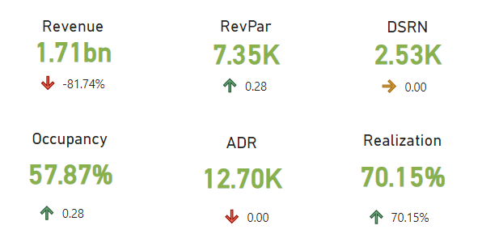
Situation
The hospitality business operates in multiple cities in India offering different types of rooms.
Metrices like Revenue, RevPar, ADR, Occupancy%, and Realization are calculated to identify high-level business insights.

Slide 4
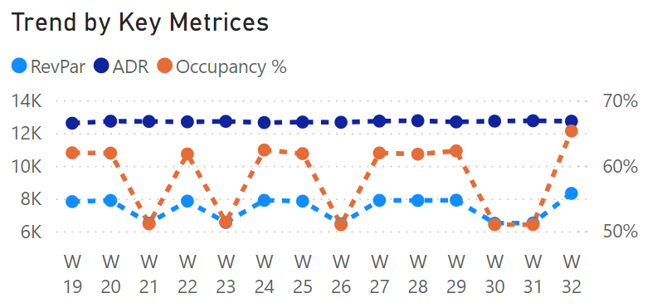
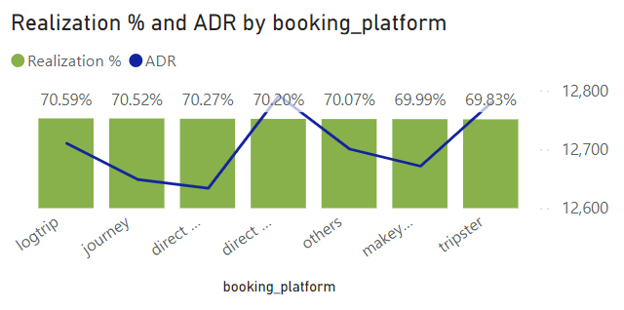
Complication
There is a significant drop in total Revenue by 81.74% causing the critical concern about business profitability.
ADR looks constant throughout the period, implying that no pricing strategy is implemented in the business.
Some booking channels and business websites are underperforming compared to offline bookings and other channels.
Hotels with lower average ratings tend to have lower occupancy rates and higher cancellation percentages.

Slide 5

Question
How can a business optimize its KPIs, such as Revenue, ADR, occupancy, Realization, etc., across different cities and channels?

Slide 6
Answers
Providing incentives on direct online booking rather than differential pricing on different channels.
Focus on dynamic pricing based on the elasticity of demand.
Addressing the cancellation rate by analyzing the reviews and customer feedback.

